Slide 1



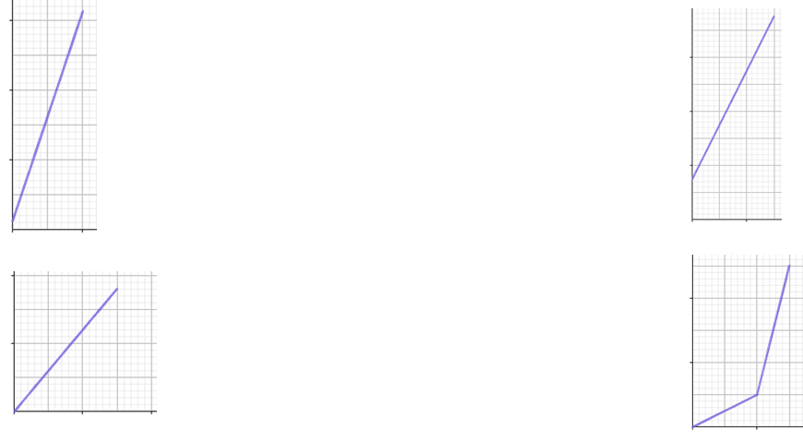
Graphing direct proportion
Task A: Features of graphs
1) Which of the following tables show that A and B are in direct proportion? Give a reason for your answers.
a) c)
b) d)
A | B
3 | 96
12 | 384
A | B
152 | 60.8
6 | 1.8
× 4
× 4
× 0.4
× 0.3
A | B
16 | 12
4 | 2.9
A | B
17 | 30.6
45 | 81
× 0.25
or
÷ 4
×
× 1.8
× 1.8
2) Which of the following graphs show two variables that are in direct proportion? Give a reason for your answers.
a) c)
b) d)
It has a constant positive gradient but the intercept is not zero.
It has a constant positive gradient but the intercept is not zero.
It has a constant positive gradient and the intercept is zero.
The intercept is zero but the gradient is not constant.

Slide 2
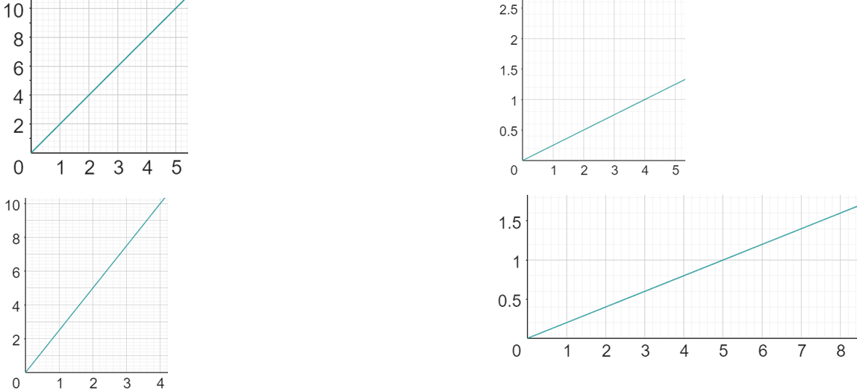

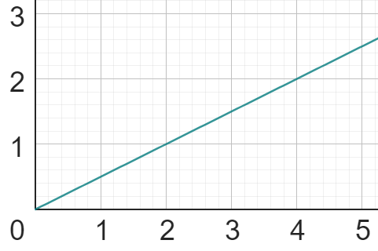
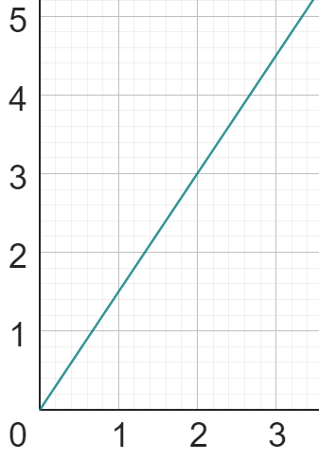
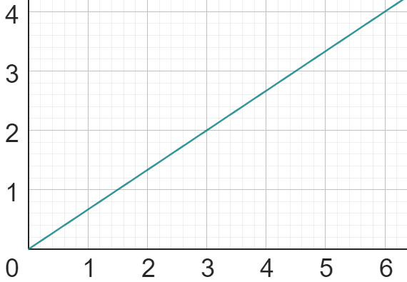
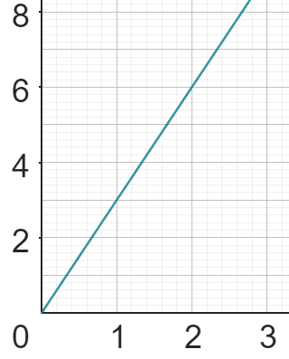
Graphing direct proportion
Task B: Graphs representing direct proportion
1) Calculate the value of k (constant of proportionality) from the following graphs:
a) c)
b) d)
y
y
+2
+1
k = 1 ÷ 4
= 0.25 or
+1
x
k = 2
+4
x
y
y
+6
+3
+0.6
+2.4
k = 6 ÷ 2.4
= 2.5
x
x
k = 0.6 ÷ 3
= 0.2
2) Match each table, equation and graph.
a)
A
C
y = 3x
x | 0 | 2 | 4 | 6 | 8
y | 0 | 3 | 6 | 9 | 12
i)
ii)
y = 0.5x
b)
x | 0 | 1 | 4 | 7 | 10
y | 0 | 3 | 12 | 21 | 30
B
D
iii)
y = 1.5x
c)
x | 0 | 6 | 18 | 24 | 30
y | 0 | 4 | 12 | 16 | 20
iv)
y = x
d)
x | 0 | 2 | 8 | 12 | 18
y | 0 | 1 | 4 | 6 | 9
C iii)
D i)
B iv)
A ii)
Mathematics in Education and Industry
v2.3

